Slide 1



Animal Disaster Preparedness
2024

Slide 2







Agenda
Introduction
Pet Preparedness Tips
Grab List
PHaR
Q&A

Slide 3
Virtual House Keeping Items
This webinar will be recorded.
All participants will be muted.
If you have a question, please add it to the chat or wait until the Q&A part of the webinar.
Please be respectful of the audience and presenters.
All content will be shared after the webinar via email and on the City of Louisville website.

Slide 4
Introductions
Kiana Freeman
Recovery & Resilience Manager
David Crawford Co-Founder and Executive Director
Animal Help Now

Slide 5


Staying Informed
Sign up for emergency notifications
  BOCOAlert & Reachwell
Weather Applications
Preparedness Applications

Slide 6

Everbridge/BOCOALERTS
Opt-In Alerts
Types of Alerting
  Call
  Text
  E-mail
Manage your account
  Add up to 5 addresses
You will only get notifications for impacted areas near one of the addresses affiliated with your account.
And the most impotant thing: the audience won’t miss the point of your presentation

Slide 7
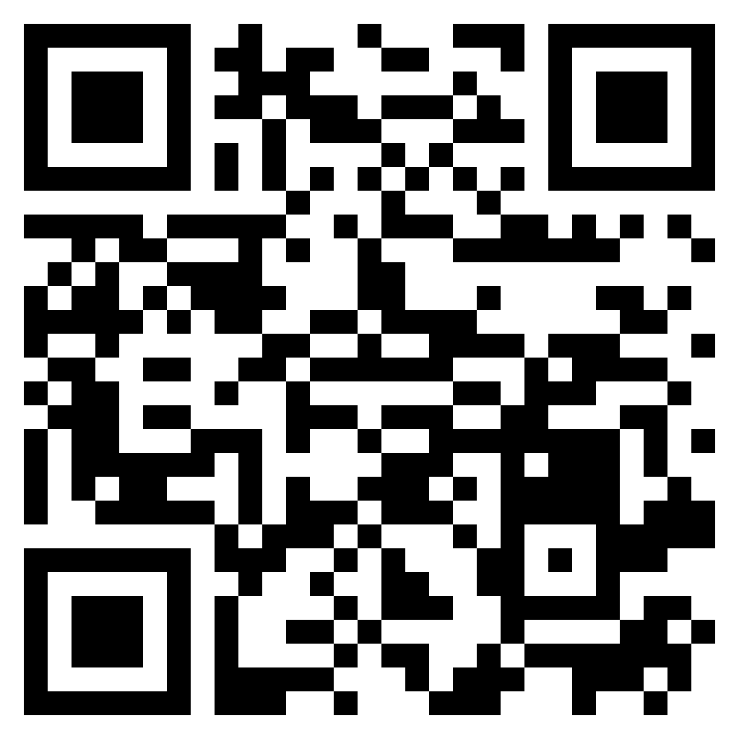
Scan to sign-up, or visit www.BOCOalert.org

Slide 8
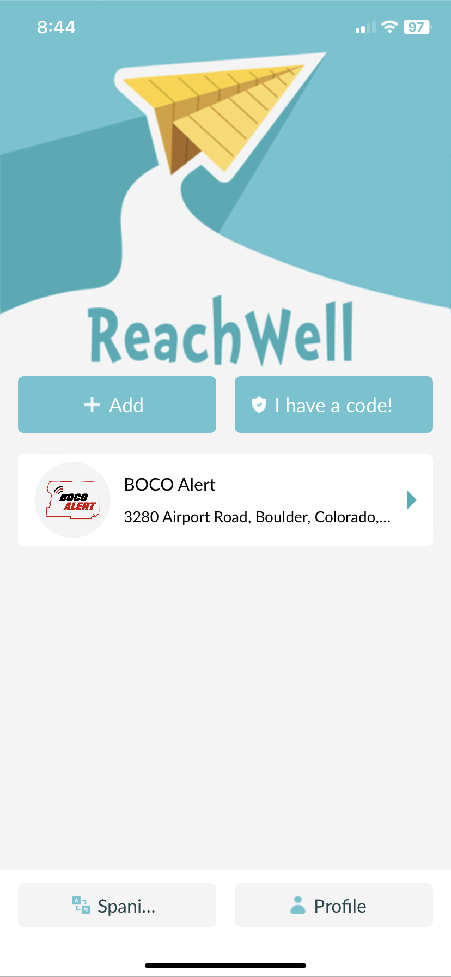
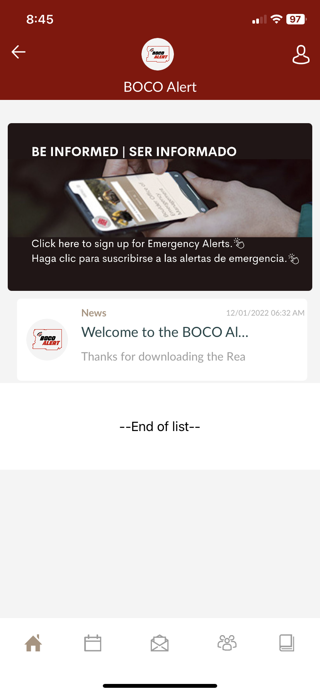
ReachWell Translation App
Phone app
  Download, then search for BOCO Alert
Provides alerts in over 100 languages

Slide 9
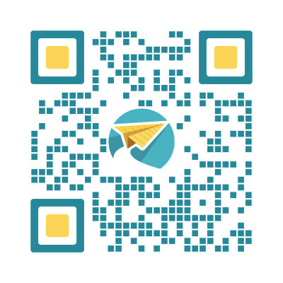
Scan to download the ReachWell App

Slide 10
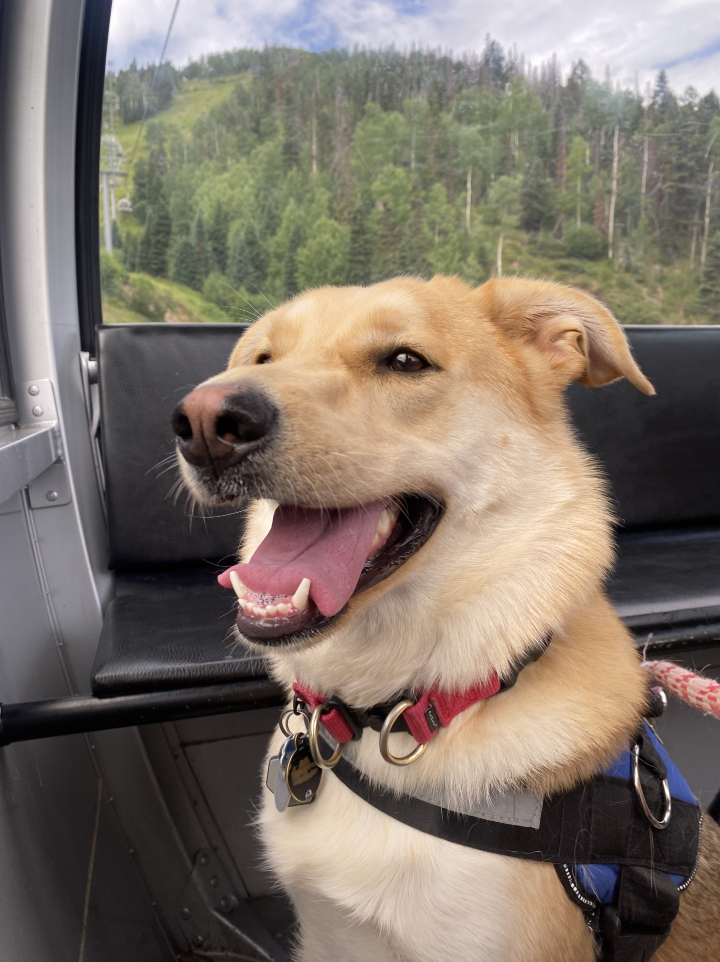
Knowing Your Pets
Behaviors & Reactions
  Hiding, Reactive, A Runner, etc.
Anxiety
  People, other animals, noises, etc.
Health Concerns
  Is there a health concern for your animal?
  Are they on medication?
  Does something happen when they are stressed?

Slide 11
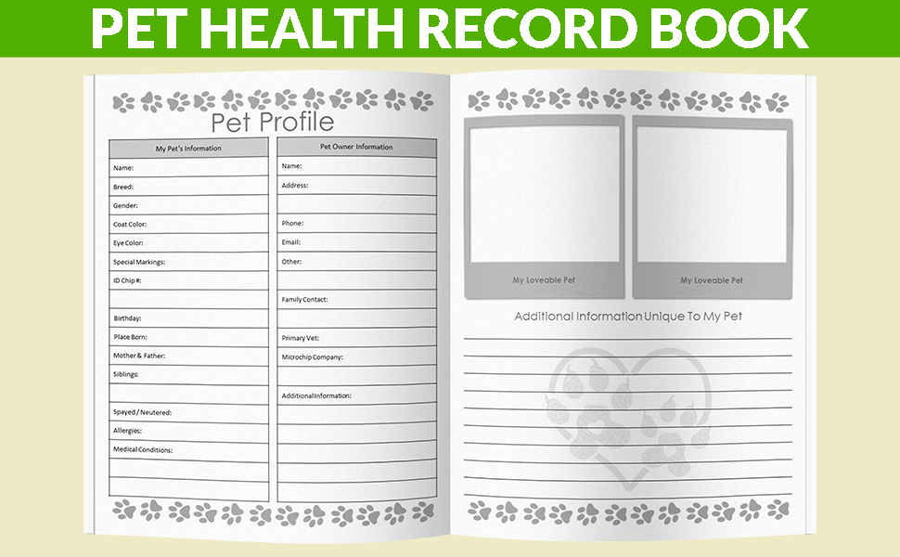

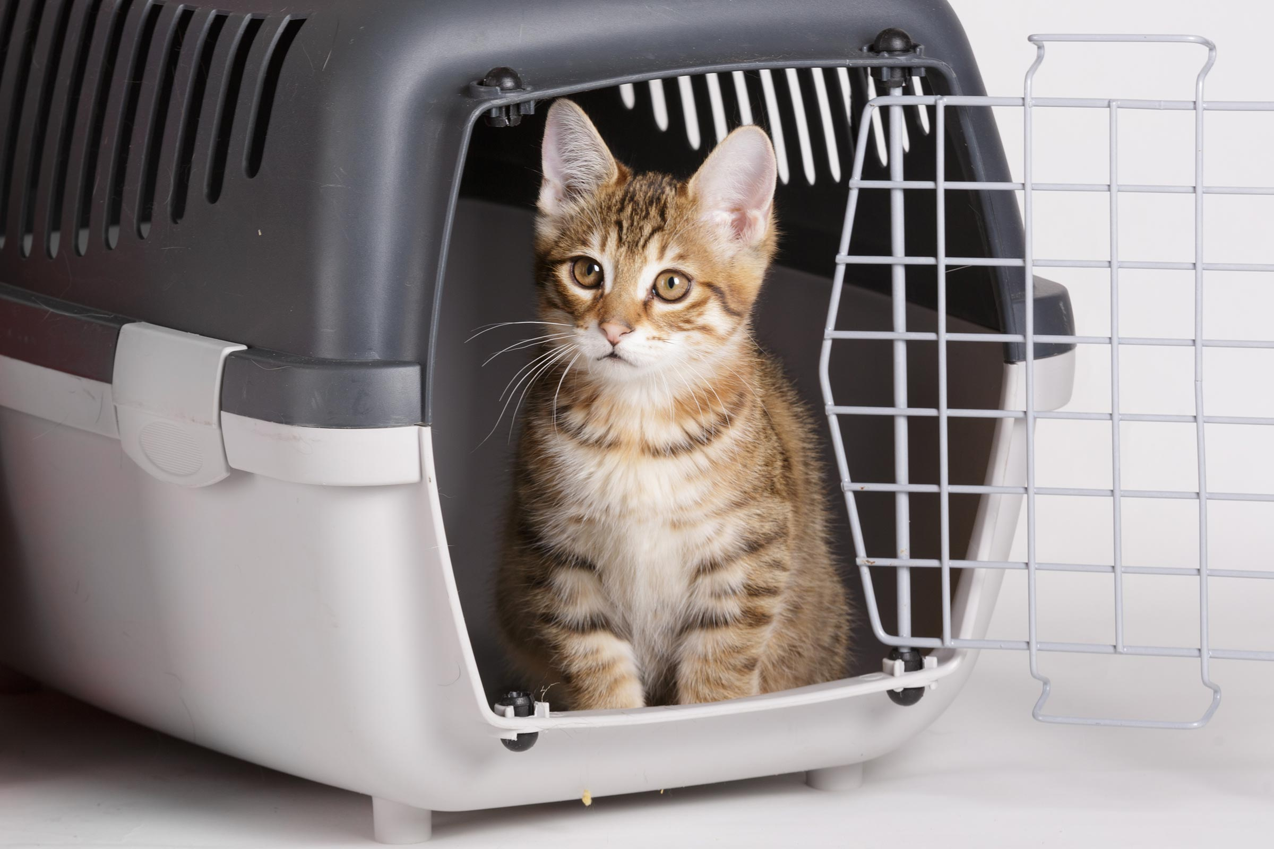
Grab List & Kit For Pets
Generalized List
Extra Food (on-hand)
Water
Bowls
Medicine
Identification & Photos
  Microchipped, collars, tags
Carrier/crate
Leashes
Toys, comfort items
Bedding (blankets, hidebox, straw, etc)
Emergency Contacts
  People & Vet & could add daycare too!
Paperwork (vaccines, health information)
First aid kit

Slide 12
Grab List & Kit For Pets
Generalized List
Extra Food (on-hand)
Water
Bowls
Medicine
Identification & Photos
  Microchipped, collars, tags
Carrier/crate
Leashes
Toys, comfort items
Bedding (blankets, hidebox, straw, etc)
Emergency Contacts
  People & Vet & could add daycare too!
Paperwork (vaccines, health information)
First aid kit
Additional Considerations
Animal specific
  Litter
  Filtration drops
  Tank needs
  Trailers
  Catch net

Slide 13
Make a Plan For Your Pet
Build a Kit
Build a grab list & kit
Document
Write instructions on how to evacuate your animal.
Share
Share with neighbors
Write habits, behaviors, and tips about your animal
Take / print pictures of your animal
Share with Friends / Family
Discuss what would happen to your animal with your family

Slide 14
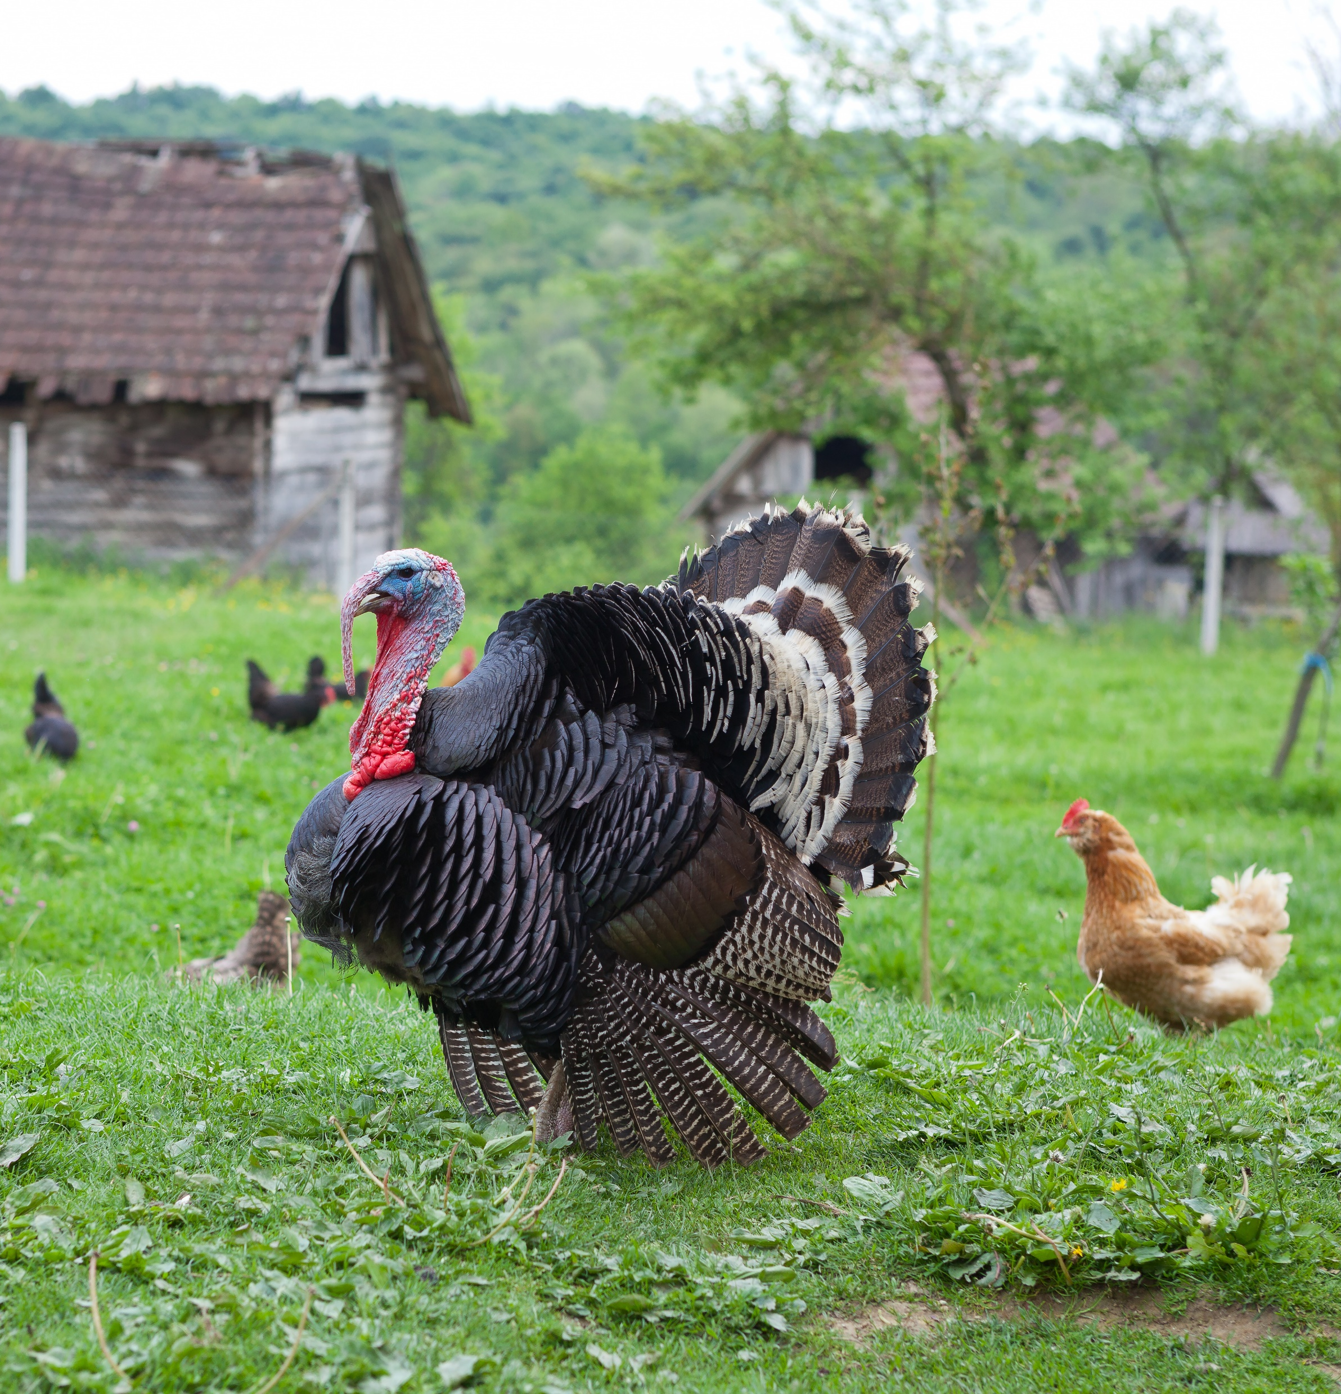
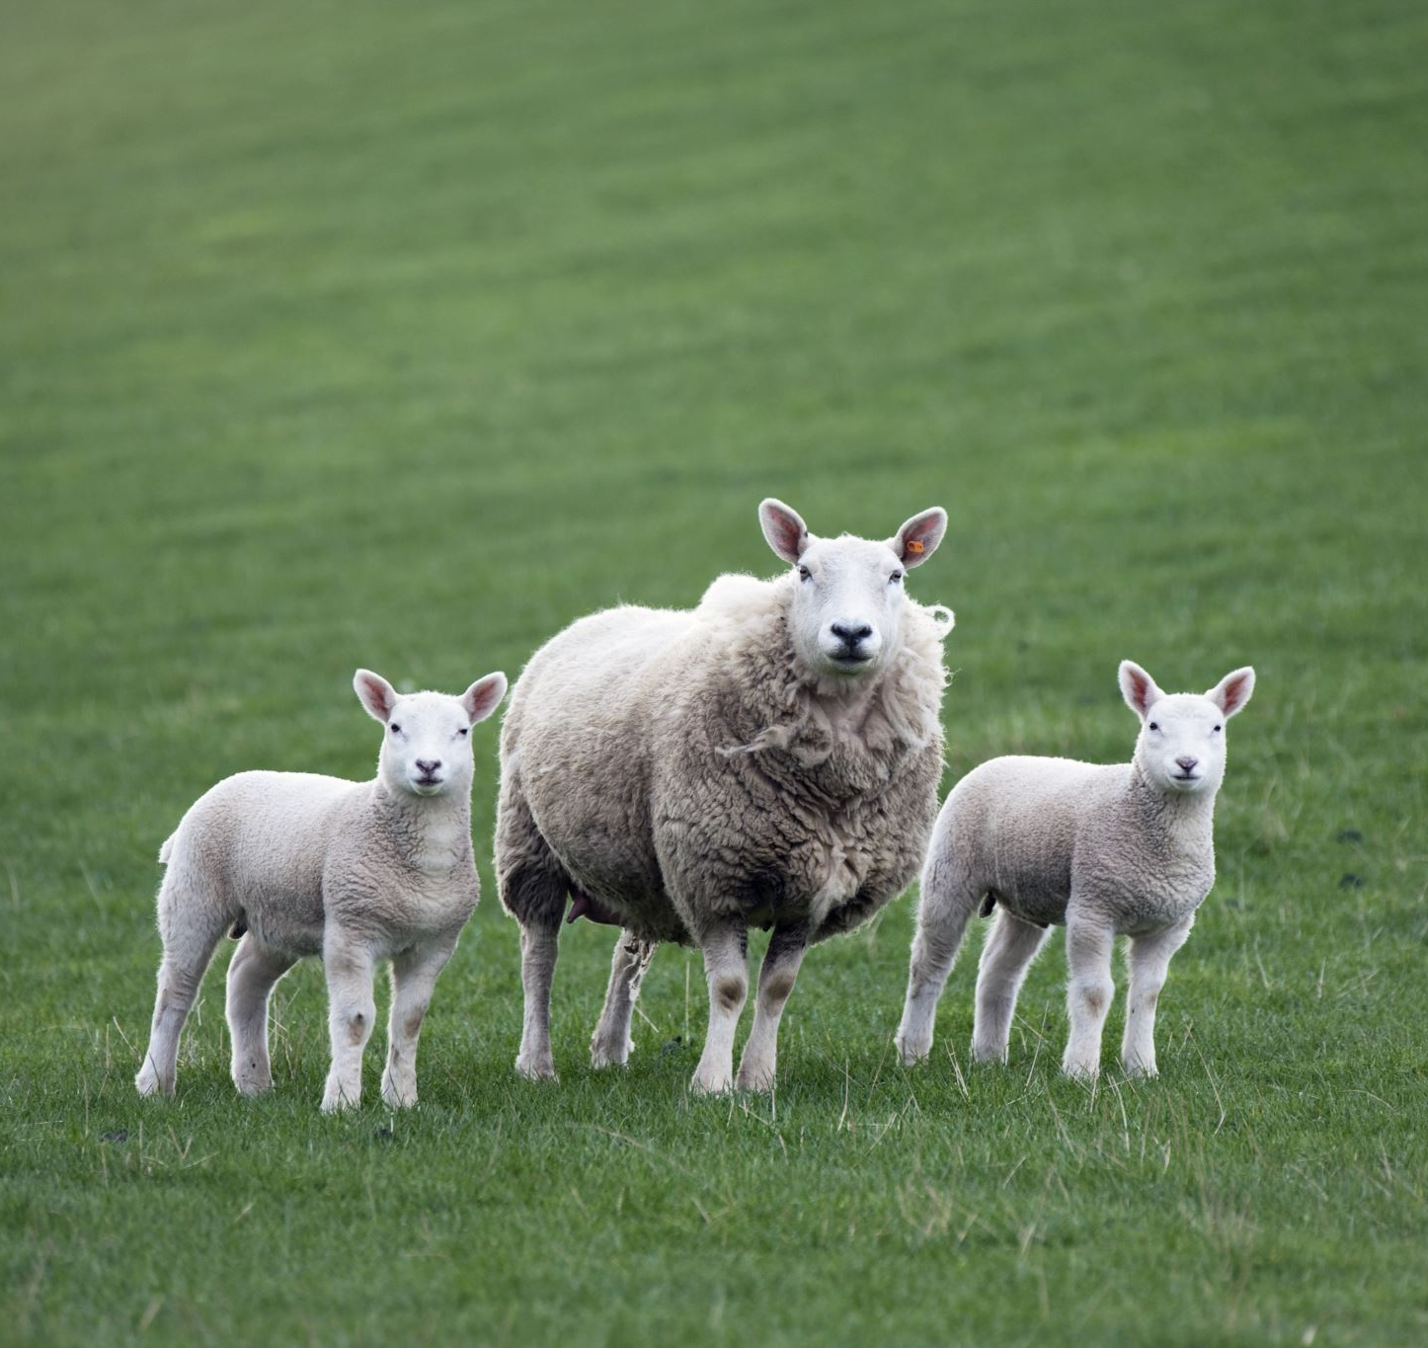
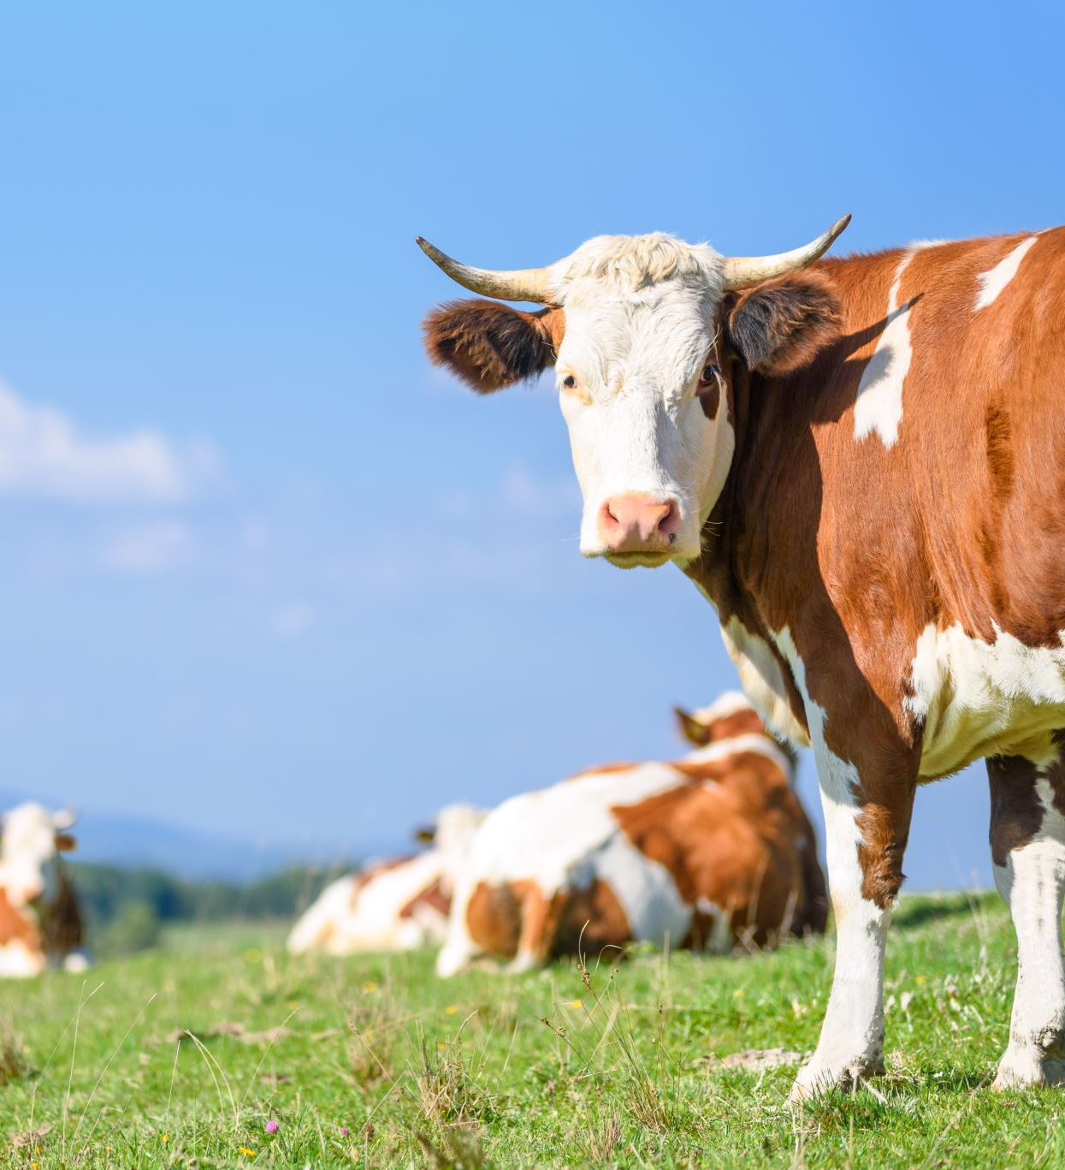
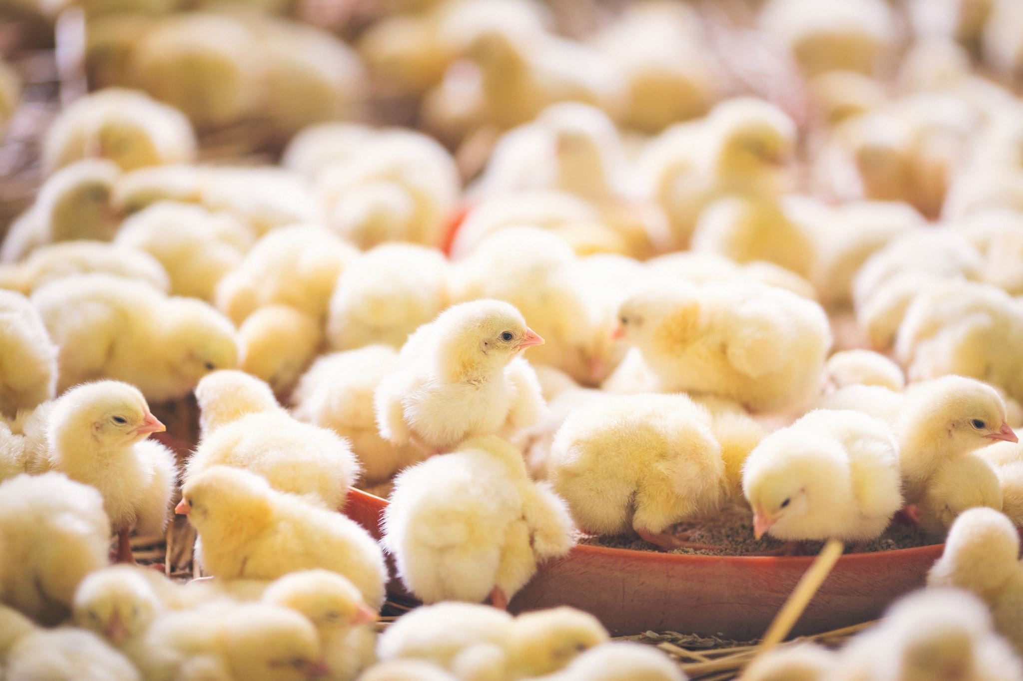
What about Livestock & Farm Animals?

Slide 15
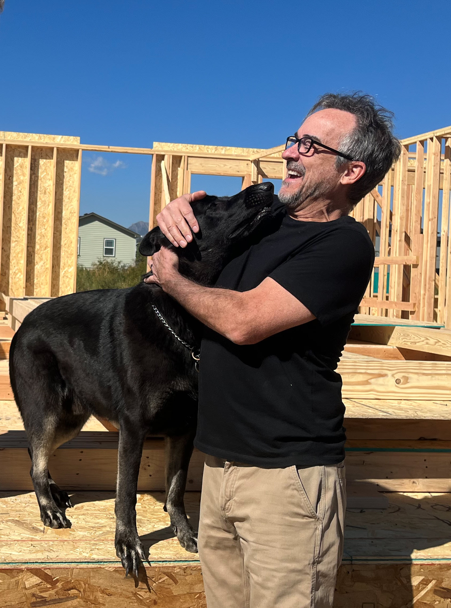

Do Your Pets Know Your Neighbors?

Slide 16






Additional Resources (click on the icon)

Slide 17

Contact Us!
Kiana Freeman
David Crawford
Email: kfreeman@louisvilleco.gov
Phone: 720.990.3369
Email: davidc@ahnow.org
Phone: 303-324-5861

Slide 18
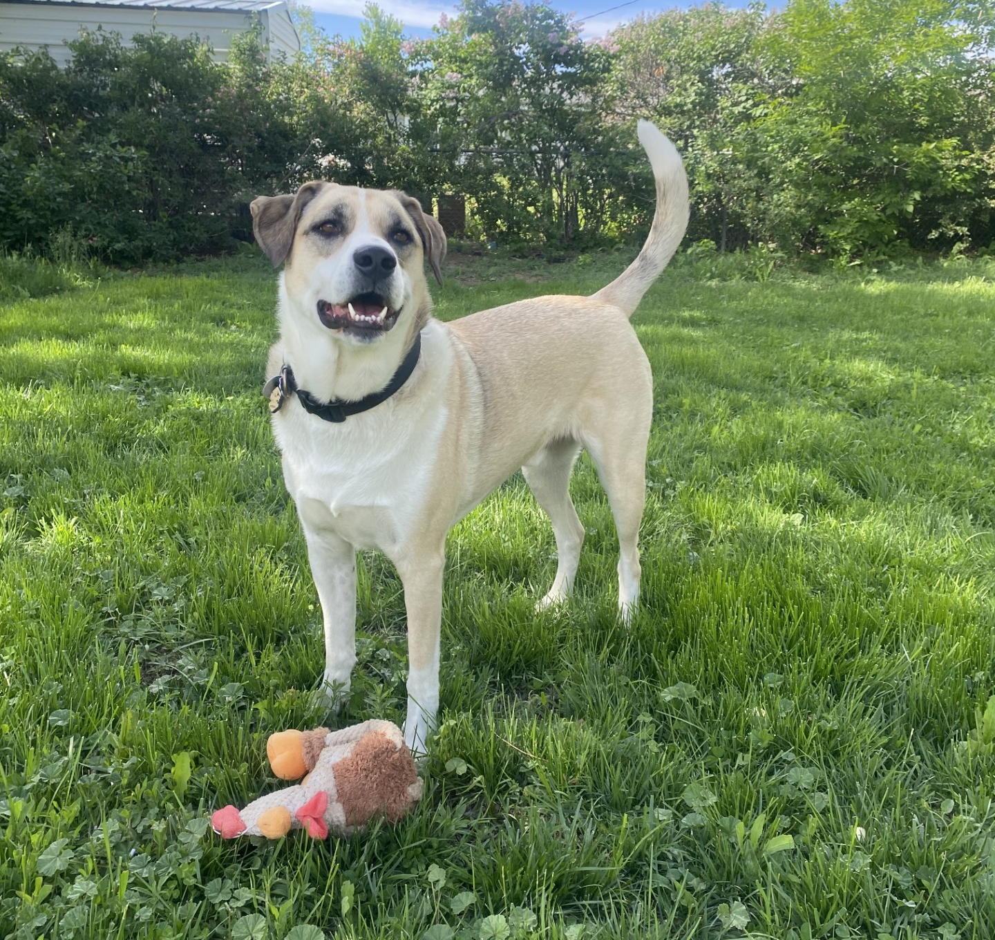
Questions?

